Slide 1
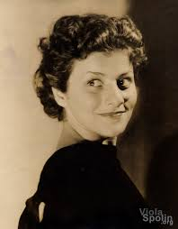
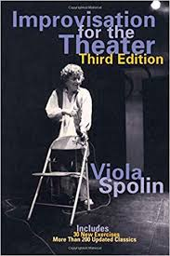
Viola Spolin
Notes:
Viola Spolin Official Website
Viola Spolin Video

Slide 2
What is the method?
A player can be in the present time and can react to any situation that mind come up during the act
Viola Spolin taught this in a form of a game
If a player focuses and pays attention the scene they should be able to do improv

Slide 3
Example

Slide 4
Method Exercises
Method Replay
game involving the entire cast
the player in the middle must translate back and forth between players on either side who speak in gibberish
Who Am I?
A player is sent out of earshot and upon their return, they must interact with fellow players until they are aware of the famous or occupational identity the audience has chosen for them.

Slide 5
Opinion on the Method
We really like Viola Spolin’s method because the idea of Game Theater has been really helpful in teaching the next generations of actors how to learn improv.

Slide 6
History of the Method
From 1965- 1967, Viola Spolin began exploring the methods of acting and story theater. She would go to Game Theater, a place where they would pull audience members onstage to act with the actors. She basically invented the improv methods of today just by teaching a game to people in the audience.

Slide 7
Citations
Viola Spolin Official Website
Viola Spolin Video
Michael Scott Improv Class
Seasons of Love Parody

